Slide 1

COEN 166 Lab Assignment 4 Instruction

Slide 2
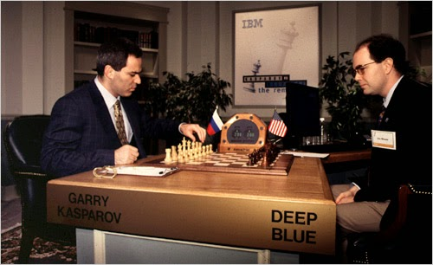
Minmax Game

Slide 3
Minmax Game
Zero sum game: It means to “kill” each other. The victory of one party indicates the failure of the other party, such as chess, Gobang (five-in-a-row), etc.
Perfect information: Players know all the previous steps. Chess is perfect information. Because the player is playing alternately, and the previous steps can be reflected on the chessboard. However, rock–paper–scissors is NOT.
Such games can be represented using a tree view, showing each possible steps. For example, in the following tic-tac-toe game, Max represents yourself and Min represents your opponent.

Slide 4
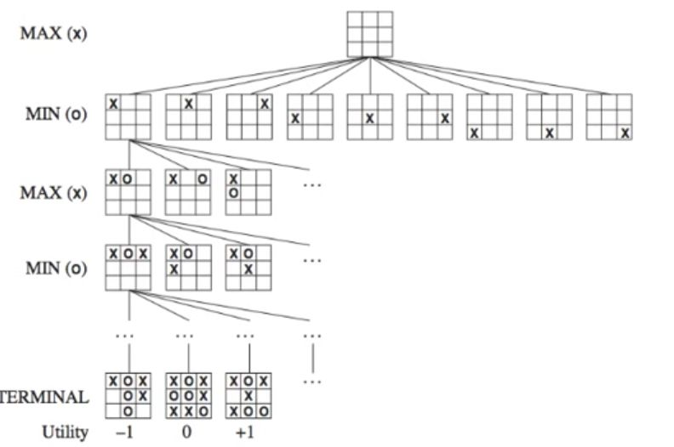
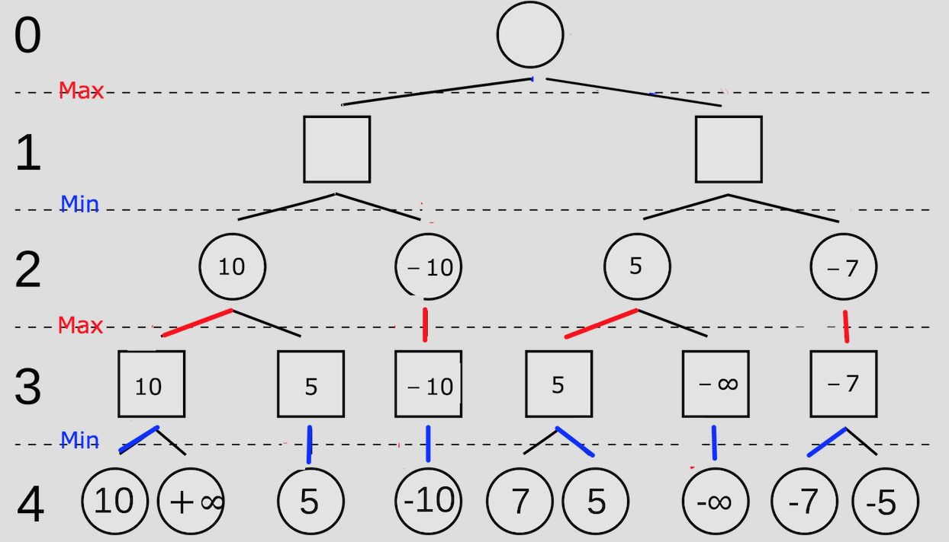
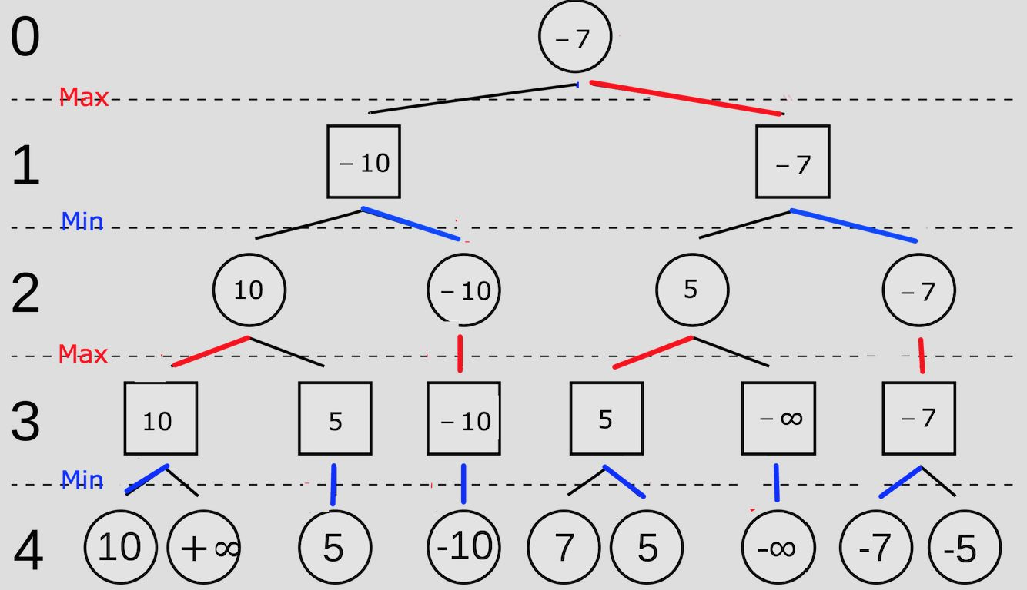
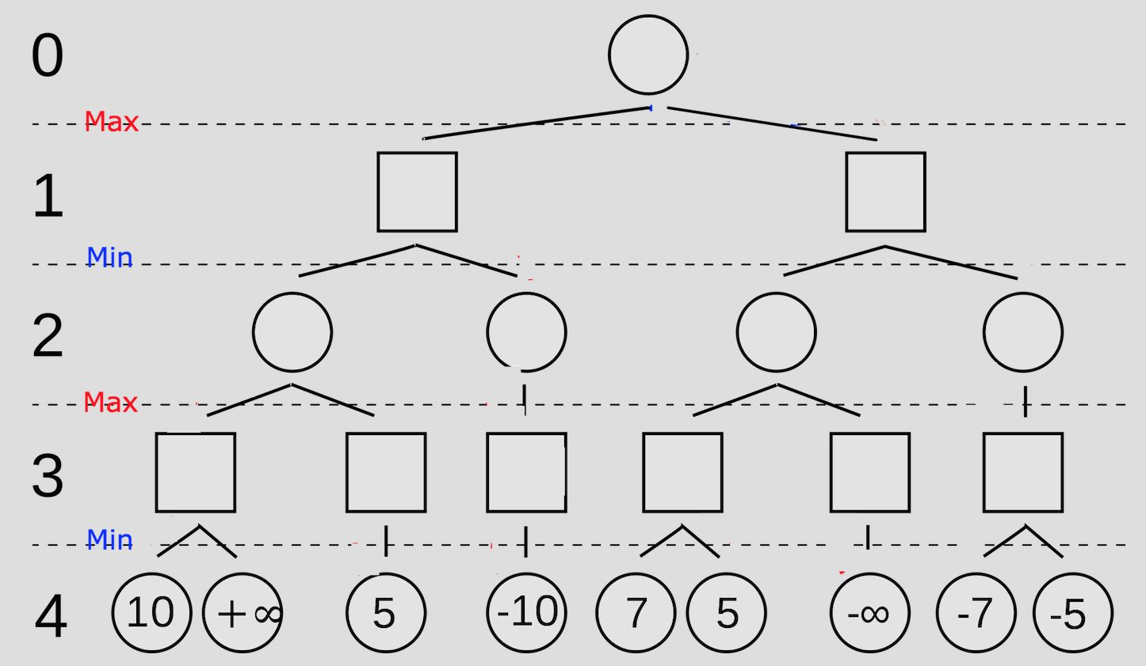
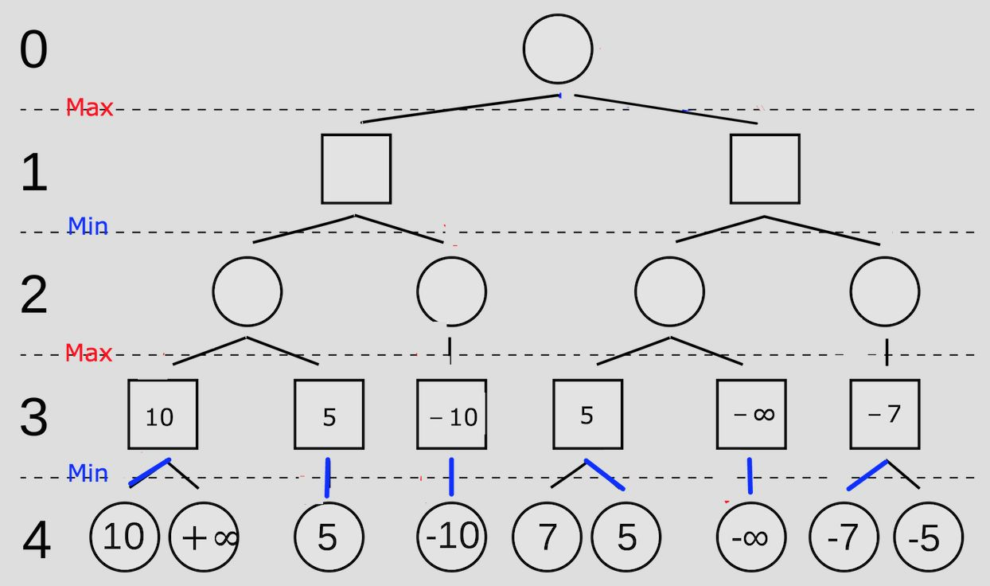
Minmax Game

Slide 5
Files you will edit:
multiAgents.py | Where your multi-agent search agent will reside.
Files you might want to look at:
pacman.py | The main file that runs Pacman games. This file also describes a Pacman GameState class, which you will use extensively in this assignment.
game.py | The logic behind how the Pacman world works. This file describes several supporting classes like AgentState, Agent, Direction, and Grid.
util.py | Useful data structures for implementing search algorithms. You may find some functions defined here to be useful.

Slide 6
What you need to program:
Implement the following function in Class MinimaxAgent:
def getAction(self, gameState):
…
# This function will
• recursively call a “max” function and a “min” function.
• propagate the “leaf” node values to upper layers, until the root node is reached.
• finally, return the best action for player-max (Pacman) at the root node.

Slide 7
class MinimaxAgent(MultiAgentSearchAgent):
def getAction(self, gameState):
…
# inside the getAction function, you will define the following two functions:
def maxValue_fun(state,PlayerIndex, other arguments if needed):
…
def minValue_fun(state, PlayerIndex, other arguments if needed):
…
# commands in the getAction function will call the maxValue_fun function, which will then return the best action for the root node
…

Slide 8
Remarks:
• for non-root nodes, only pass the “value” to upper layer
• for root node, return the best action
• For a certain node on the tree, if no action is available at the corresponding state, then just return the score of that state.

Slide 9
Testing
We expect Pacman to win at least 5 out of 10 successive games.
Your code should also pass 5/5 tests of the following: python autograder.py -q q2 --no-graphics

Slide 10
Demo
• How does the “max” function work?
• How does the “min” function work?
• How to recursively call the “max” function and “min” function?
• How is depth=4 reached?
• How does the root node return the best action?
• How do you set the PlayerIndex for Pacman and for three ghosts?
• When depth<4, how to go from the 3rd ghost to the next player-MAX, and at the same time increase the depth by 1?

Slide 11
Report
Explanation of the code implementation:
o Max_function (getLegalActions, generateSuccessor, return the max value or the best action, etc.)
o Min_function (getLegalActions, generateSuccessor, return the min value, etc.)
o Recursive call of max_function and min_function
o How is depth=4 reached?
o How does the root node return the best action?
o How is the PlayerIndex for Pacman and for three ghosts set?
o When depth<4, how to go from ghost 3 to player MAX? Meanwhile, depth increases by 1

